Slide 1

Succeed ~ Happy ~ Independent ~ Nurtured ~ Excited
with perseverance ~ with respect & honesty ~ and courageous ~ with compassion~ with teamwork
Our School Vision
“To be the best we can be for ourselves and others”

Slide 2
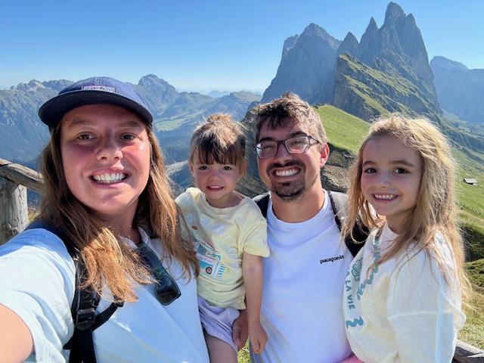
A bit about Mrs Clark…
I have two daughters – Martha and Elsie. Elsie has started school this year.
I studied BEd Primary Education with QTS at the University of Gloucestershire. I specialised in Geography and English. I have also completed an NPQLT (Leading Teaching) and am currently completing my NPQH (Headship).
My roles are:
Willow Class Teacher
English Subject Lead
Foundation Subject Lead:
Art, DT, Computing
Subject Leader for ODST:
Geography and DT

Slide 3
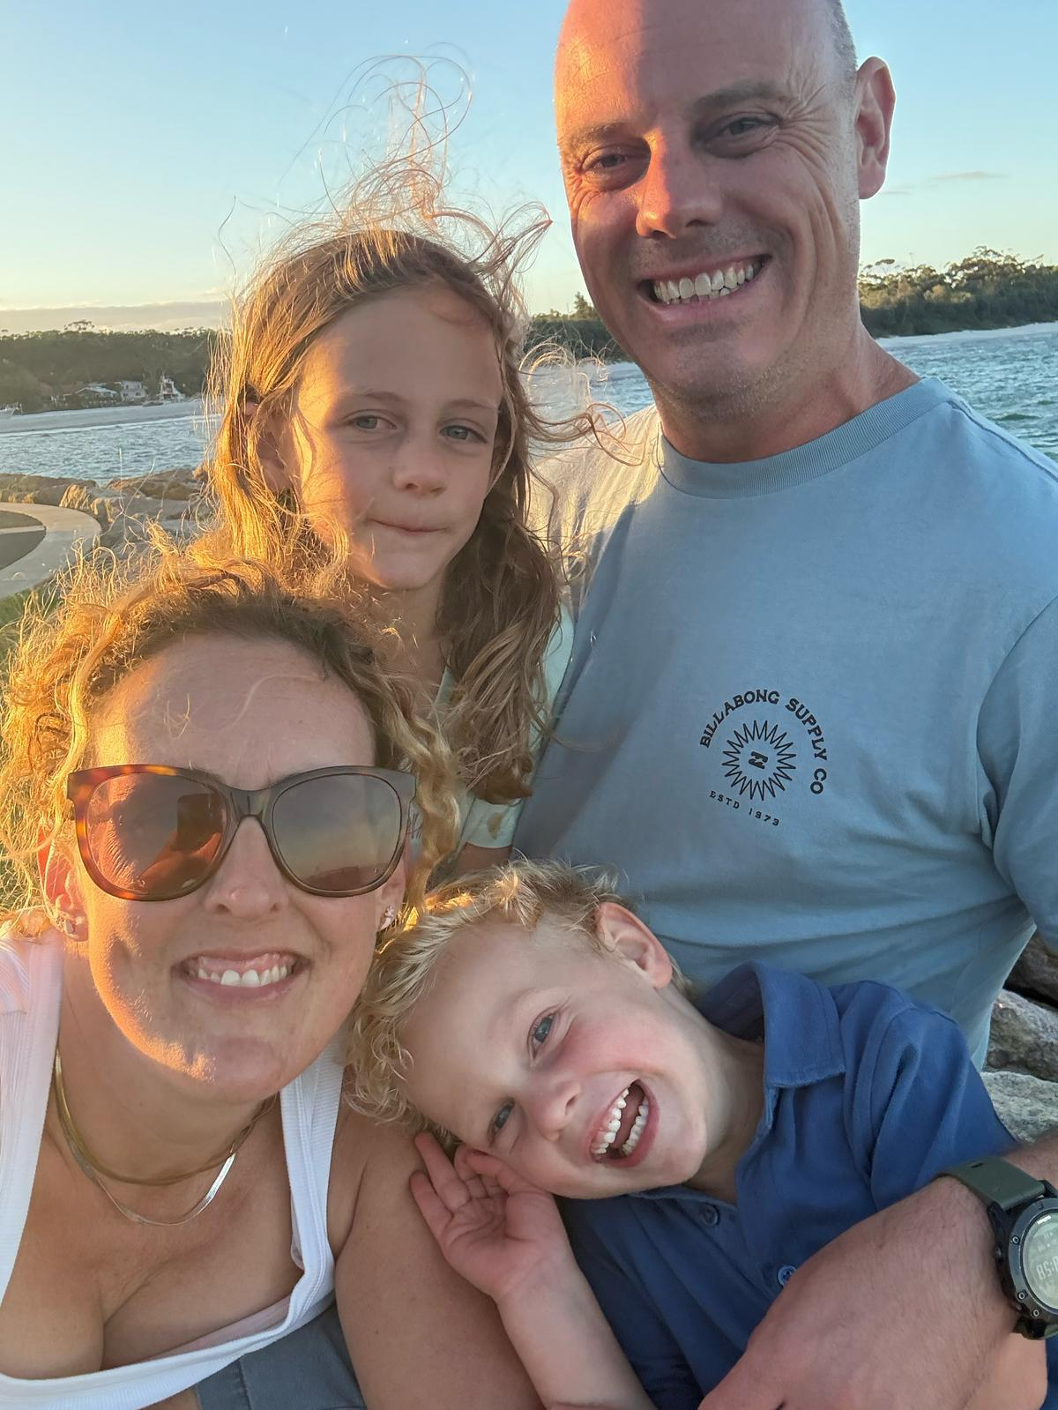
A bit about Mrs Brook
Hello, I’m Mrs Brook!
I’m a military wife and feel very lucky to have travelled the world with my husband and our two young children.
I have a BA (Hons) in English and, after loving my time working in Year 1, I’m really excited to be joining the Year 5/6 team. It’s a big change, but one I’m very much looking forward to!
I’m really looking forward to getting to know your children, supporting them to build confidence, discover their strengths and grow throughout the year. I can’t wait to see what we can achieve together and make lots of happy, fun memories along the way!

Slide 4
Example Weekly Timetable
WB: | 8.40 -9.00 | 9.00-9.20 | 9.20 - 10.30 |  | 10.30-10.45 | 10.45 – 12.00 |  | 12.00-1.00 | 1.00-3.00 |  | 3.00-3.15 | A/S
Mon | EMA | Collective Worship | Fluent in 5 | Maths | B | Dictation | English | L | RE | PSHE | News
Tues | EMA | Collective Worship | Fluent in 5 | Maths | R | Dictation | English | U | Spanish | PE | Story
Wed | EMA | Collective Worship | Forest School |  | E | Dictation | PE | N | Science | English | News
Thurs | EMA | Collective Worship | Fluent in 5 | Maths | A | Dictation | English | C | Art | Guitar | Story
Fri | EMA | Collective Worship | Fluent in 5 | Maths | K | Dictation | Independent Write | H | GR 1.00-1.20 | History | Story

Slide 5
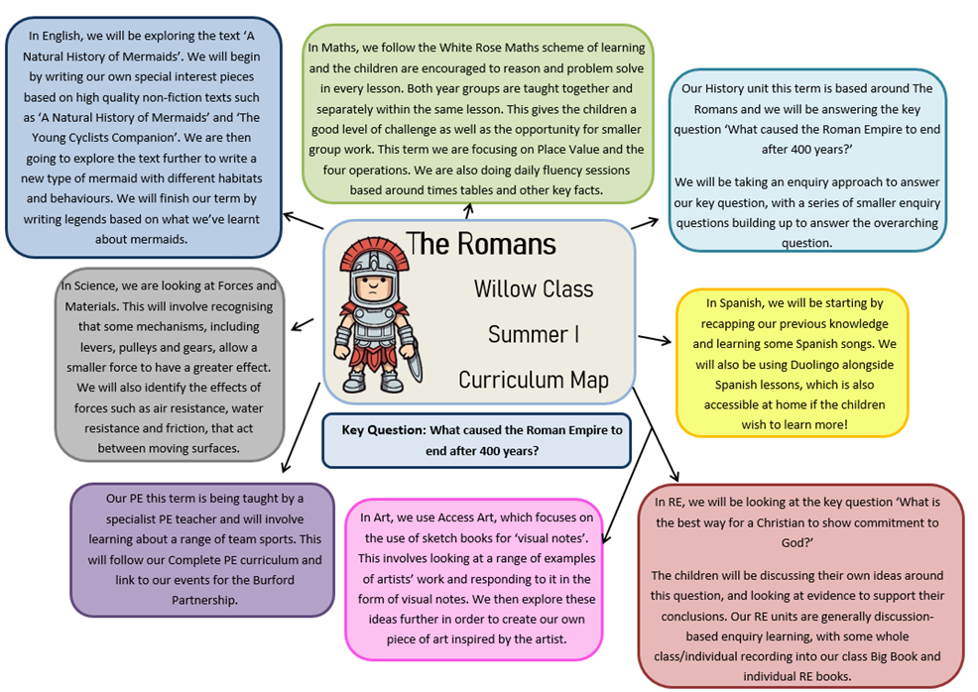

Slide 6
Trips!
We are hoping to run one trip/experience per long term.
We will endeavour to decide the trips in the next few weeks so that you can plan ahead.

Slide 7
Routines (Autumn Term 1)
Reading books changed on a Friday morning (but this can be done more frequently if necessary).
PE – Tuesday Afternoon and Wednesday Morning.
We will have regular library slots but this has not been confirmed yet. Library project pending.
Please keep an eye on Dojo for updates.

Slide 8
Tuesday Afternoon Arrangement
Mr Lenton will be teaching Willow Class on a Tuesday afternoon.
He will teach Spanish and PE.
I will be teaching History and Art to Oak Class.

Slide 9

Reading

Slide 10
How much does my child need to read?
Even in Year 5/6, reading is one of the most beneficial things you can do with your child at home.
At St Christopher’s, our whole school expectation is that children read to an adult six times a week.
Please record this in reading records. We will also record any reading we do in school.

Slide 11
Why is reading SO important?
They have better brain development, attentional and cognitive ability.
They have better school readiness and knowledge about the world.
They have better speech and language development and literacy skills.
They make more progress across the curriculum.

Slide 12
Why is reading SO important?
They feel more secure and develop deep bonds with parents/​carers.
They have healthy routines and habits.
They have better socio-emotional skills.
They have better mental wellbeing and self esteem.
More info (particularly why we’re pushing it with our older children!):
https://www.scholastic.com/content/corp-home/kids-and-family-reading-report/key-findings.html?appesp=CORP/intraapp/202411//txtl/keyFindings/kfrr//////

Slide 13
How often are books changed?
Reading books are changed on a Friday (most of the time unless we can’t fit it in)
Reading books more than once can support fluency and improves comprehension.
Children are also welcome to read other books from home/library books if they finish their banded book.

Slide 14
How often will my child be read with in school?
We will be aiming to read with all children twice across a half term, but this may be more for some.
If you feel your child is ready to move up, I am happy to read with them to check. Please be assured that we are all incredibly experienced with book banding and always want children to move up if they can. We will never hold them back!

Slide 15
Why Whole Class Reading?
Teaching the whole class instead means that all pupils can read with the teacher more often, moving faster through more or longer texts and benefiting from the teacher’s expert explanations, modelling, questioning and feedback.
Explicit focus can be placed on different reading skills each lesson.
Children can share ideas with their peers and have the opportunity to ask their own questions.

Slide 16
English

Slide 17
Audience and Purpose
In English, we focus on the Audience and Purpose of a text.
The main purposes are: To entertain, to inform and to persuade, but there are so many others!
Our lessons will be based around exploring texts and learning how to write for our audience and purpose.
A successful piece of writing will meet the intended audience and purpose.

Slide 18

Maths

Slide 19
How will maths be taught?
We will be following the year plan from White Rose Maths, with the majority of planning being done using the WRM schemes of learning.
These are free to access online if you would like to see how we teach certain concepts.
We are lucky to have a spare classroom to split into, so some of our lessons will be split by year group.

Slide 20
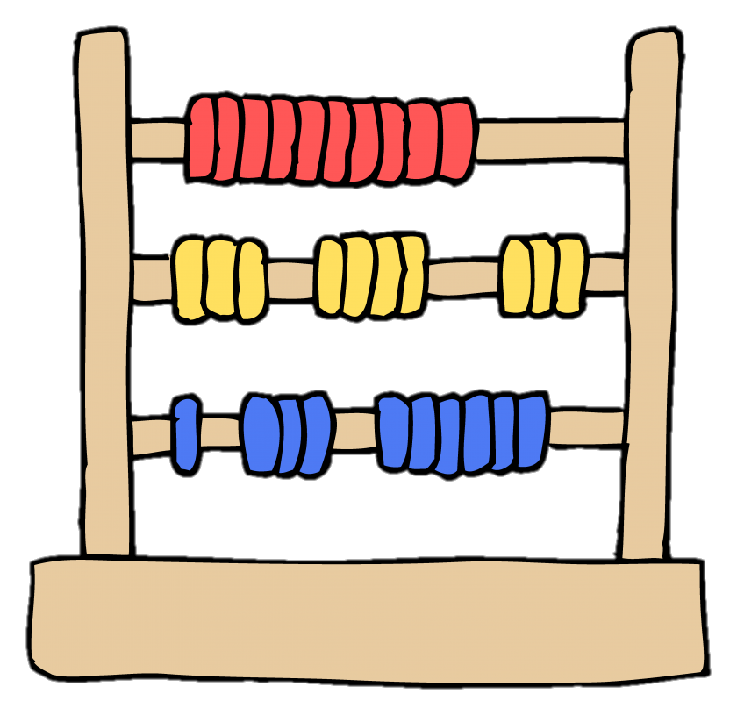
Manipulatives
Manipulatives and resources are a key part of learning in maths and should not be seen as a negative.
All children will be encouraged to use manipulatives as much as possible to support their learning.

Slide 21
History and Geography
New Curriculum – Year D
Each KS2 class will study the same unit of work.
This will then be explored at different levels based on the age group, with key questions being the focus for enquiry-based learning. We build our board up as we go, adding key information, vocabulary, pictures and questions.
Our first History enquiry question is:

Slide 22
Homework

Slide 23
- Read six times per week.
- Regularly practise times tables on TTRS and any other ways that suit your family.
- Practice spellings regularly using strategies from spelling journal. These will be tested weekly in class.

Slide 24




Homework – Year 6
Parent feedback – prepare for Year 7!
+ STRETCH

Slide 25
Uniform
Black skirt/trousers/pinafore/shorts
White polo shirt – with or without the school logo
Plain grey/ black or white socks/tights
Black shoes or boots (predominantly black with little colour or decoration, no trainers, open toed sandals or high heels)
Blue school sweatshirt/hoodie/cardigan (preferably with logo).
During the summer months a blue gingham dress may be worn.
No jewellery (other than small stud earrings that should be removeable for PE and Swimming etc.)

Slide 26
PE Uniform
White T-shirt- with or without logo
Blue shorts or navy jogging bottoms
Blue PE Hoodie with school logo
Plimsolls or trainers
Our PE day is Monday, but kit should be in school from Monday – Friday in case the PE days change due to weather etc.
It would be great if children could learn to tie their own laces if they have laced trainers – we spend a lot of time tying shoelaces before/during PE lessons.

Slide 27
Behaviour

Slide 28
Behaviour Expectations
This year, we are really focusing on behaviour in KS2. We have already had lots of conversations about what ‘being the best’ might look like in school.
We have also discussed Year 6 responsibilities and privileges including sitting on benches in assembly, house captains and playground leaders.
I use a countdown from 5, with the expectation that by ‘1’ everything is out of the children’s hands and they are quiet and ready to listen.

Slide 29
High Expectations
As with any class in the school, there are very high expectations for behaviour in Willow Class.
Alongside our rewards for ‘being the best’, there are consequences for children who make poor choices.
Children must feel safe and secure in school so that they can learn.
It is important that we are all working together and that these high expectations are mirrored at home.

Slide 30
Fidget Toys
We have a selection of fidget toys in school for children to use if needed.
Please do not allow your child to bring fidget toys into school from home.
They can break/get lost. This can cause upset.
They often cause more distraction than support.
There is evidence to suggest that they can be detrimental to learning if not used correctly.

Slide 31
Year 6 Responsibilities and Privileges
The children are aware of the importance of being role models within the school and being aware of their behaviour at all times. There are some Year 6 jobs as well as Year 5 jobs.
Year 6s sit on benches at the back of the hall. This is a privilege and the children are aware of the high expectations for behaviour.
The playground leader rota has been decided. Playground leaders will have one early lunch a week, on the day they are running their activities.
House captains will be voted for in the coming weeks. Any child who would like to be a house captain can write a letter explaining why they think they’d suit the role.

Slide 32
Rewards
Marble Jar – Oak Class can collect marbles by working as a team to follow instructions and listen carefully. Marbles are given when the whole class has been working hard. A whole class reward happens when the jar is full.
House points – These are individual rewards which are collected at the end of the week. The winning house is revealed in Friday’s assembly.
‘Be the Best’ Certificates – these are hand out in Friday’s assembly. It is closely liked to our school vision and one child per class will win each week.
Whole School Learning Hero – One person out of the whole school is chosen by the teachers each week. This is for outstanding behaviour/effort/learning and general ‘being the best’.

Slide 33
SATs
We aren’t hiding from the fact that SATs are happening at the end of the year for our Year 6 children.
However, I will not be putting any pressure on children to ‘revise’ or ‘practise’ for their SATs. There will be simple homework tasks, but please don't think I'm 'drilling' them for SATs – that is not the case!
Some children have already asked about SATs so conversations will be happening in class. I’ll try to keep it to a minimum!
Around October Half Term, letters will go out about SATs Booster Groups. There was 100% positive feedback from these last year and they really made a difference. They are not compulsory but strongly recommended!

Slide 34
Pioneer
There will be a meeting closer to the time for all pioneer related information and questions.
Please look out for the date!

Slide 35
How can you contact me?
If you have any major concerns about your child or something that has happened, please ring the office and arrange a meeting with me. A face to face meeting is the best way to resolve larger issues. Long Dojo messages are sometimes misinterpreted.
For smaller, class specific questions, please do send me a message on Dojo. Please bear in mind that I will only be looking at Dojo between 8am and 4pm. I am usually quite busy in the mornings so if the message is urgent it is best to call the office. I often miss messages in the mornings!
I will be on the playground for pick up on most days.

Slide 36
A few things to bring in:
Wellies for the winter
An old shirt or an apron for art activities. Acrylic paint won't come out of uniform.
A waterproof coat every day – the children can't go out in the rain without a coat.
Full PE kit every day (plans change!)

Slide 37
A reminder...
Please don't allow your child to bring things in from home.
We have all the equipment they will need in school – no pencil cases are necessary.
All uniform needs to be clearly named to make sure it comes back to you if it goes missing.

Slide 38
Any questions?

