Slide 1
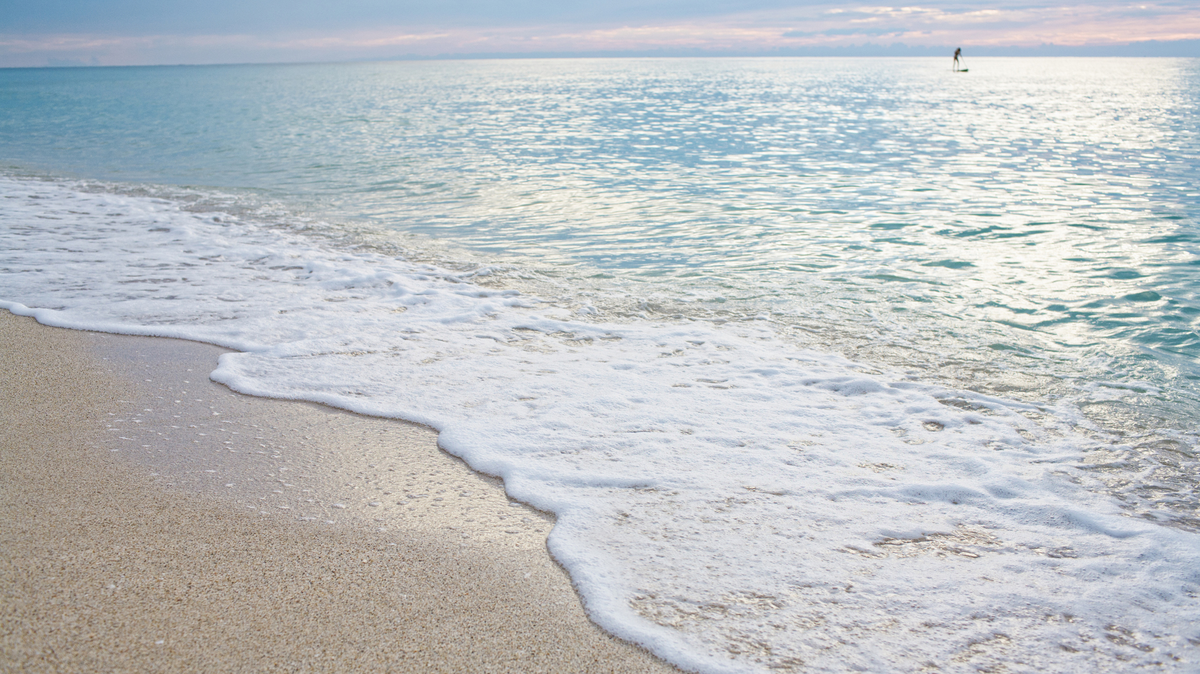
Eco Committee Assembly
Wednesday 7th February 2024

Slide 2
To be the best we can be for ourselves and others.

Slide 3

Christ the light of the world is here
Lord Jesus shine on us

Slide 4
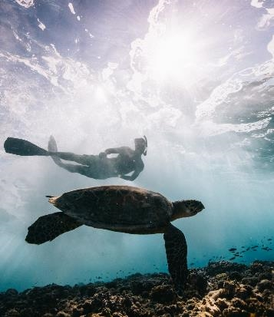
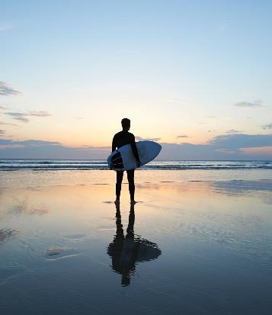
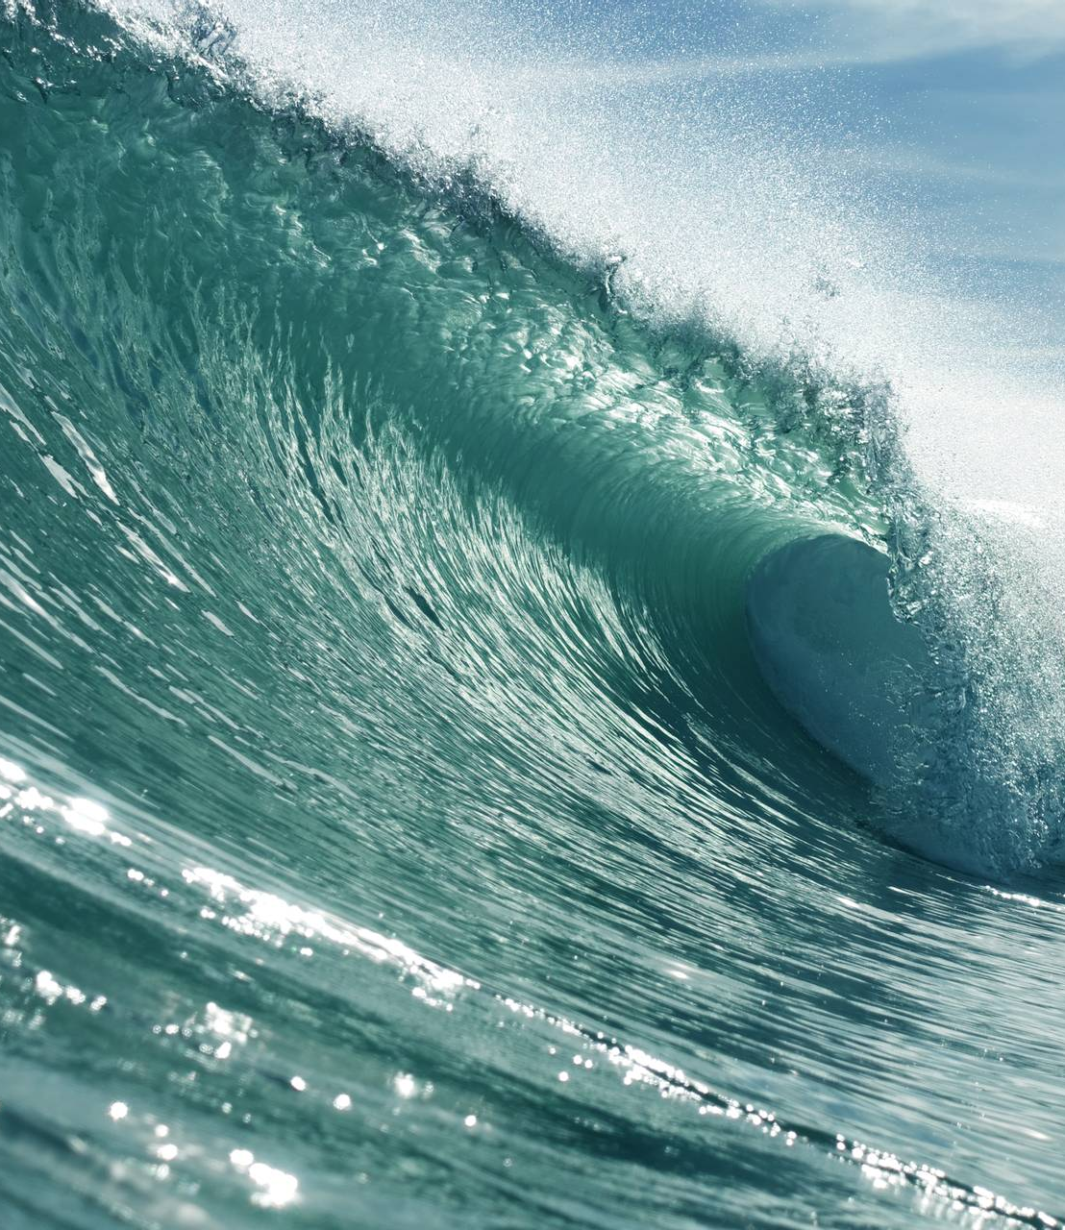
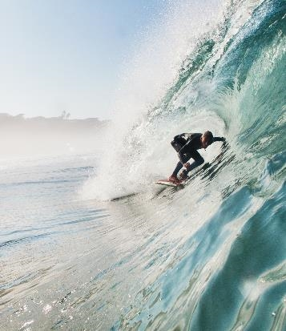
Independent and courageous

Slide 5

What we are working on this year:
Water
Marine (rivers and reducing plastic pollution)
Global Citizenship

Slide 6

Saving Water
At St Christopher’s, many taps have been left on so have decided to recruit some Water Monitors.
Lots of children wanted to help!

Slide 7
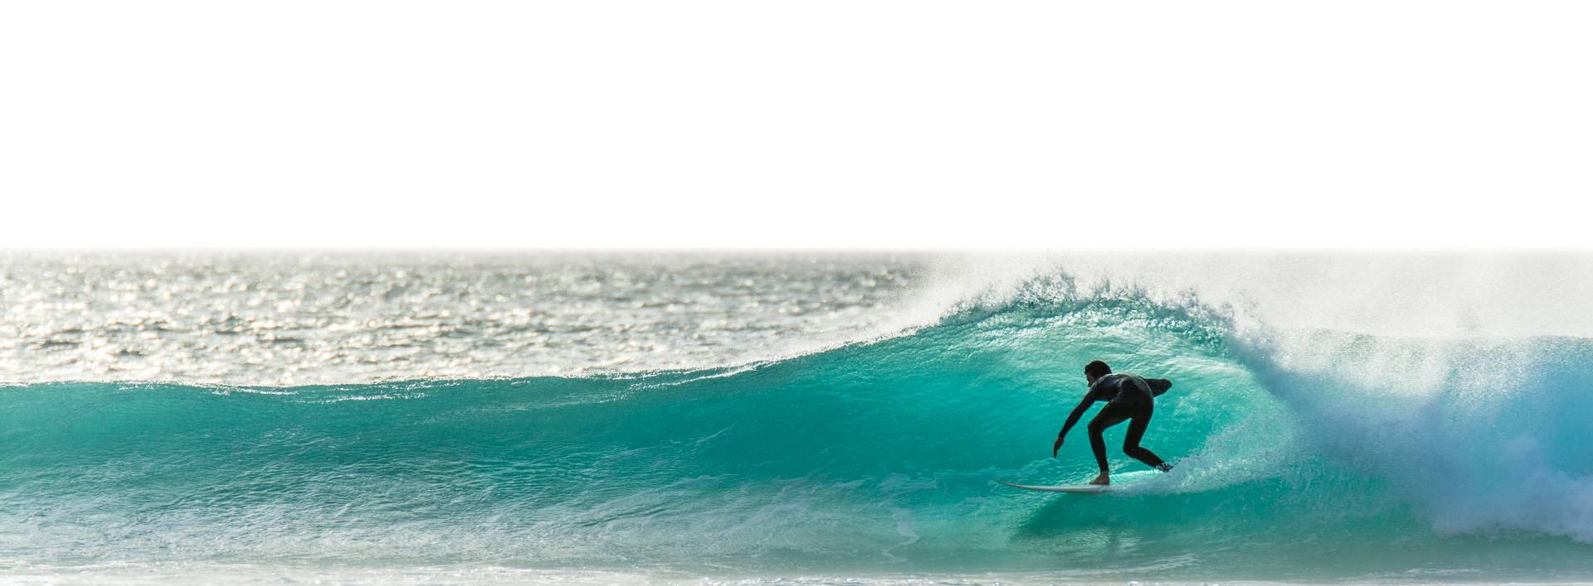
Why do you think we need water monitors in school?

Slide 8

What will the water monitors do?

Slide 9

Water Monitors will:
Turn off taps that are left on.
Report any leaks.
Report any waste i.e. big puddles on the floor.
Make sure we not wasting water in school.

Slide 10
Our new Water Monitors are:
Maple: Emily, James and Ashleigh
Ginkgo: Ralph and Violet
Oak: Phoebe and George
Willow: Evan and Bella

Slide 11

Competition time!

Slide 12
Saving Water Posters
We want you to design posters to put up around school that show how you can save water!
They should remind people why it is important to save water too.
We will pick two winning designs from the entries.
We need the posters in by Thursday 22nd February. (Please give them to teachers to look after).
Winners will be announced the following week.

Slide 13

Reflection
How can you help to save water in school?
Why is water so precious?

Slide 14

Prayer
Dear Lord,
Help us to protect our precious water and help us to be responsible and respectful to our planet Earth.
Help us to flourish in all we do.
Amen

