Slide 1

Succeed ~ Happy ~ Independent ~ Nurtured ~ Excited
with perseverance ~ with respect & honesty ~ and courageous ~ with compassion~ with teamwork
“To be the best we can be for ourselves and others”

Slide 2
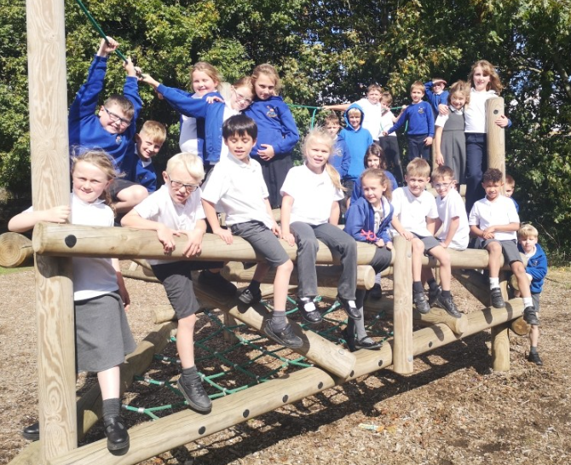
Welcome to
Oak Class
Year 3/4

Slide 3
EMA
Early Morning Activity
8.40 – 9.00
Re-cap previous learning
Respond to marking
Use ‘Working Walls’
Please be on time ☺

Slide 4
Literacy
Julie Sargent
‘Innovate Education’
Work on punctuation and grammar within the lesson

Slide 5
Spellings
TBC from Mrs Clarke
Investigations
Use it where class gaps are spotted.

Slide 6
Reading

Slide 7
At St Christopher’s we understand how important reading to an adult is. Our whole school expectation is that children read to an adult six times a week.
This needs to be reordered in your child’s reading record. Comments on how your child read, if they enjoyed the book or any challenges are very helpful.

Slide 8
We will have reading records
Any reading related messages that need to get across to myself.
Reading books available in school every day
Banded reading books to be changed Monday and Wednesday.
We aim to read with the children at least once a week.

Slide 9


Slide 10

Maths

Slide 11
Developing a strong grounding in number is essential so that all children develop the necessary building blocks to excel mathematically.
With this in mind, our Maths curriculum focuses quite heavily in the first few terms on number.
White Rose
Focuses on the use of manipulatives--→ pictoral--→ abstract.

Slide 12

Maths Homework
10 mins
5x week
Focus – 2x 5x 10x
3x 4x 8x
(Y3)
Focus – 2x 5x 10x 3x 4x 8x
6x 7x 9x 11x 12x
(Y4)

Slide 13

MFL
Numbers 0-10
Animals
Fruit
I know how…

Slide 14

RE & PSHCE
Jigsaw, the mindful approach to PSHE brings together Personal, Social, Health Education, emotional literacy, social skills and spiritual development in a comprehensive scheme of learning.
A lesson a week which helps us to focus on meeting our children’s needs and to build relationships with them, getting to know them better as unique human beings.

Slide 15
Homework
Read 5/6 times per week.
Practise x x tables.
10 mins each homework (approx)

Slide 16
PE
Royal blue shorts/skort/joggers
White T-shirt
Kit available Mon-Fri

