Slide 1
To be the best we can be for ourselves and others.

Slide 2

The grace of our Lord Jesus Christ, the love of God and the fellowship of the Holy Spirit be with you
and also with you.

Slide 4
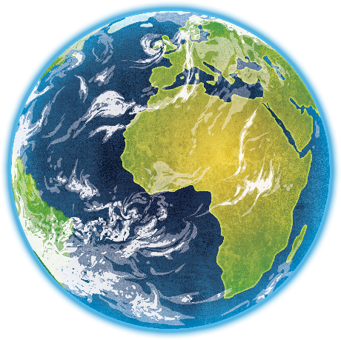

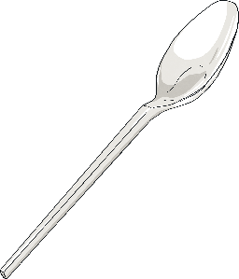

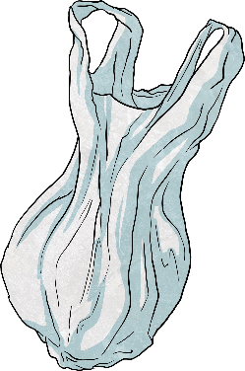
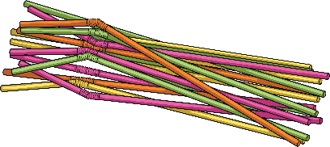
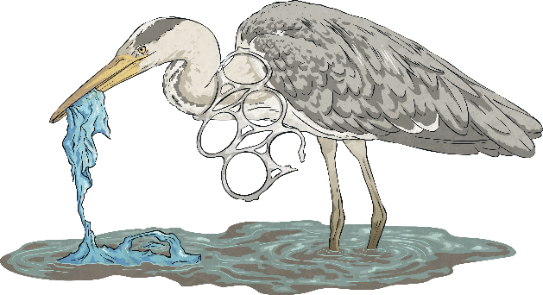
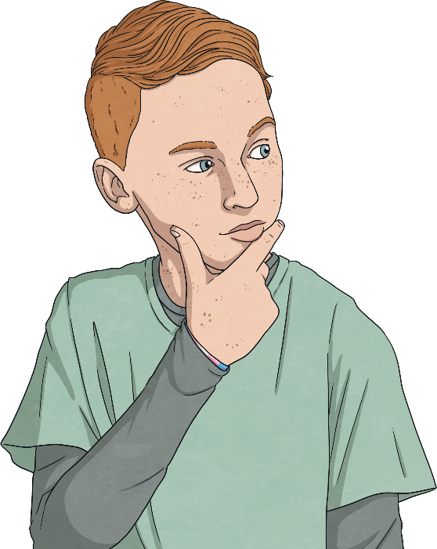
What effect does plastic have on
our planet?

Slide 5
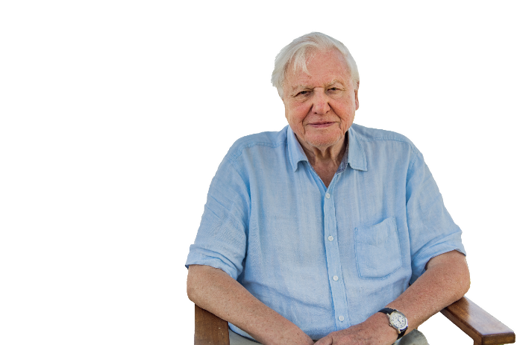
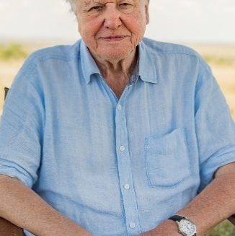
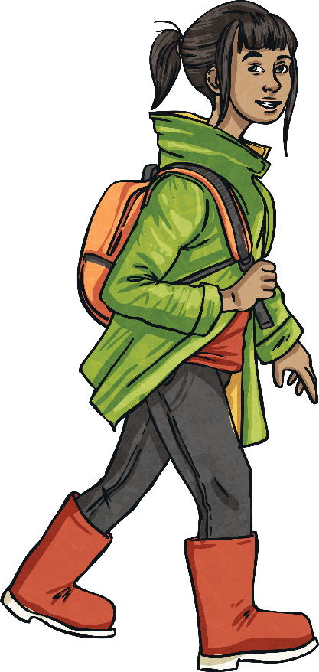
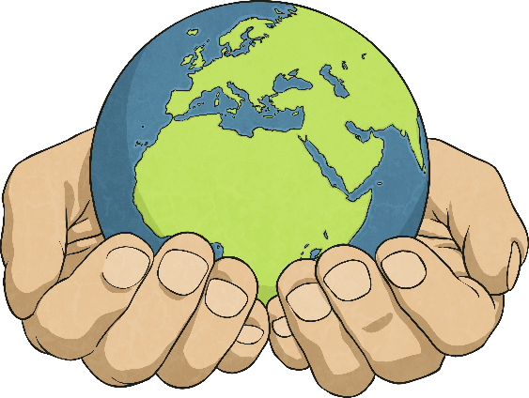
What Is Earth Day?
Earth Day is an annual, international event held on 22nd April. Its aim is to raise awareness for our planet and the environmental challenges it faces.
The first ever Earth Day was held in 1970 and since then it is recognised by more than a billion people around the world.
It is an opportunity for people to show their support for the environment and come together to take action to help protect the Earth.

Slide 6
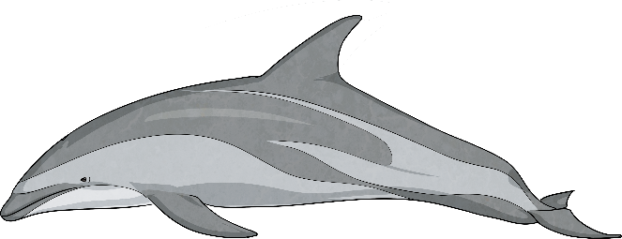
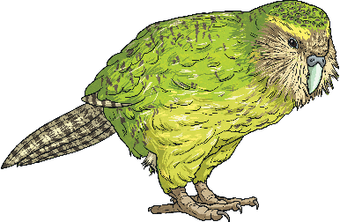
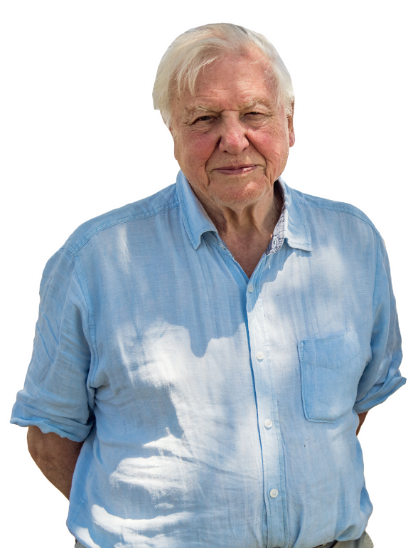

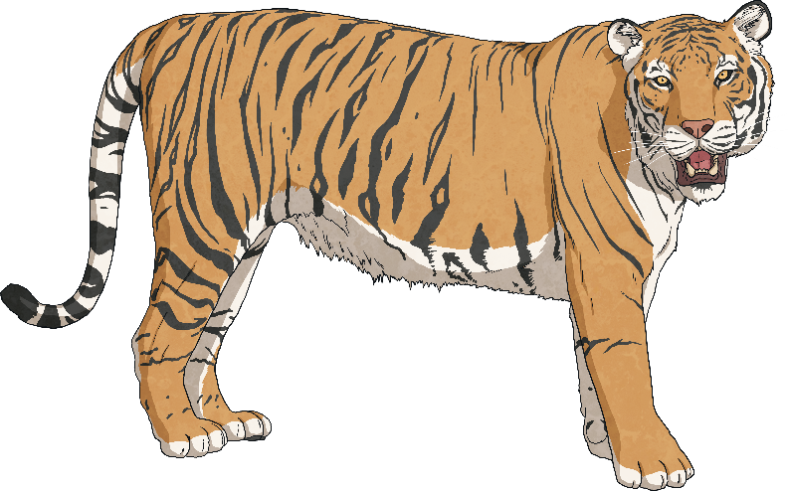
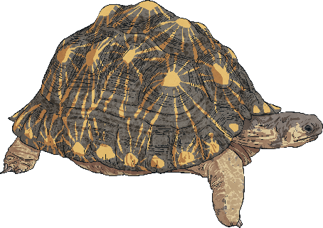
Why Is Earth Day Important?
The Earth is changing all the time and while some of these changes occur naturally, human activity has caused exceptional changes to the planet over recent years.
As the global population has rapidly increased, so has the demand for energy, land and water. This places many threats on the biodiversity of our planet.
Biodiversity means the variety of living things (such as plants and animals) in an area and how those different things depend on each other to meet their needs.

Slide 7
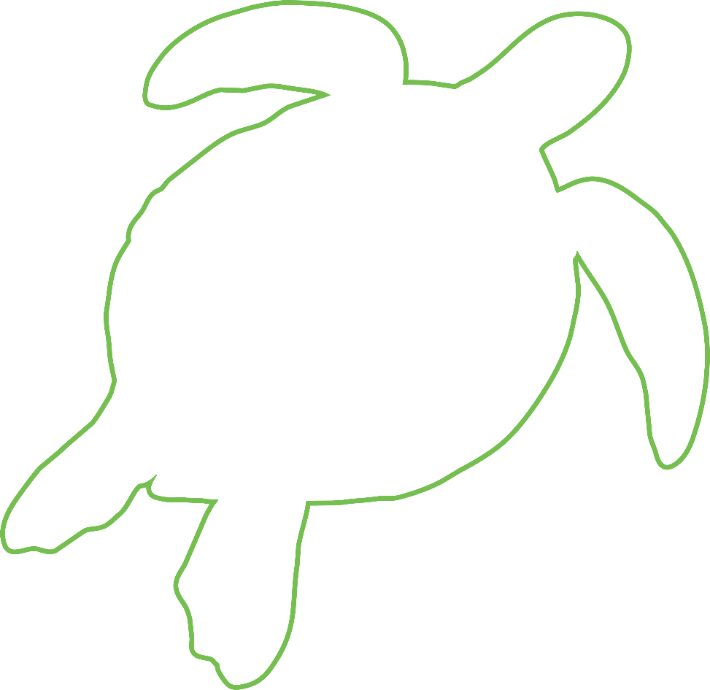
Why Is Earth Day Important?
?
Did You Know...?
Human activities have increased carbon dioxide emissions by 40% since 1850.
This has caused the global temperature to rise by approximately 1°C.
?
The current rate of species becoming extinct is up to 1000 times faster than the historical rate.
Climate change is one of the major factors behind the current mass extinction of species around the world.
?

Slide 8
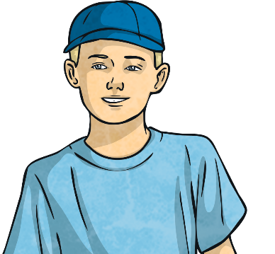
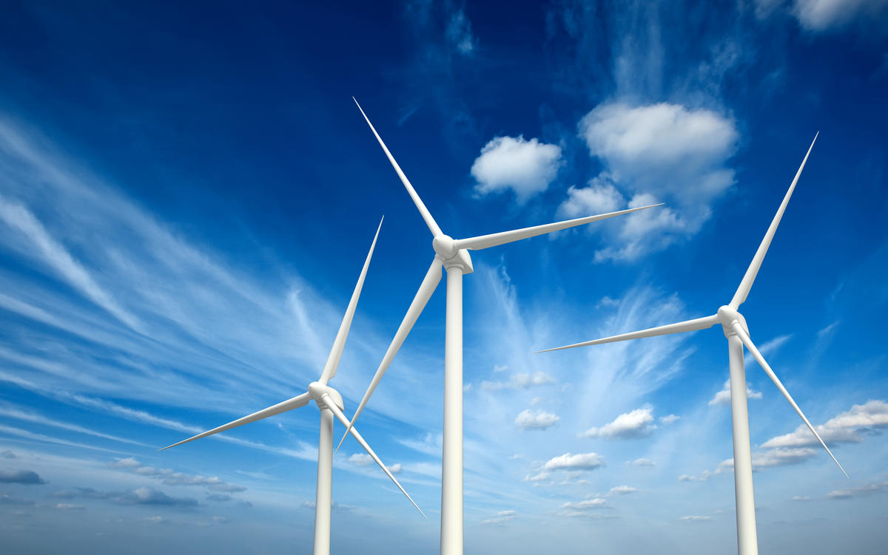
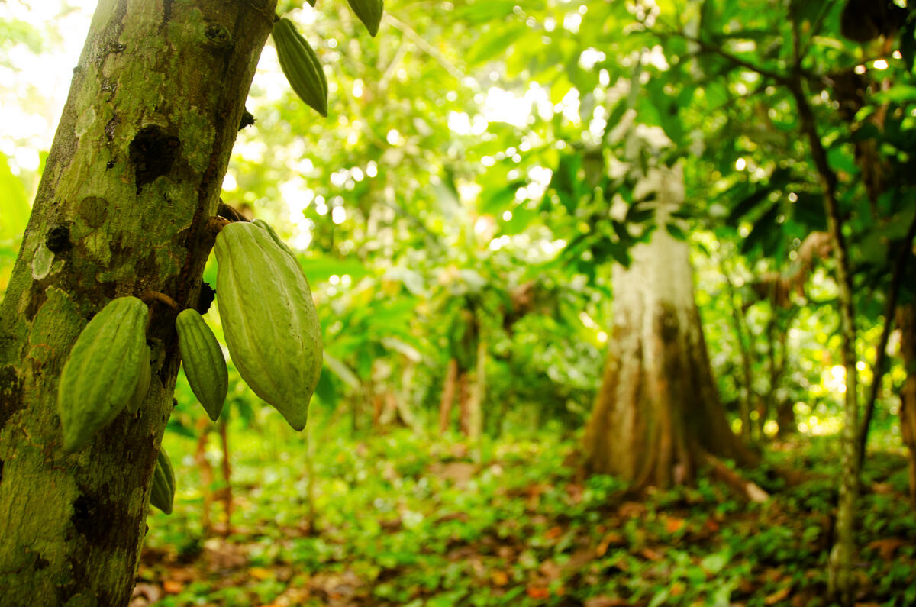
Planet vs Plastics
The theme for Earth Day in 2024 is ‘Planet vs Plastics’.
What do you think this means?
This is all about working together as businesses, governments and
individuals to reduce our use of
plastics. Plastic is a hard-wearing and long-lasting material. This means it can remain in the environment for hundreds of years. It will take everyone working together for a green and sustainable future.
Sustainable means working and living in a way which ensures there will be still be natural resources (e.g. food, water, minerals) left for future generations.
!
NOW
is the
time act!
© Shutterstock / DR Travel Photo and Video / WWF
© WWF / Jaap van der Waarde

Slide 9
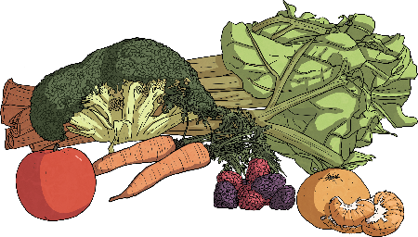
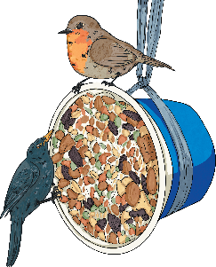
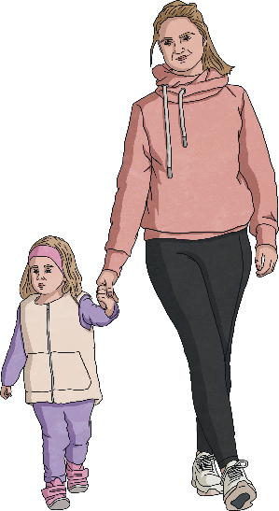
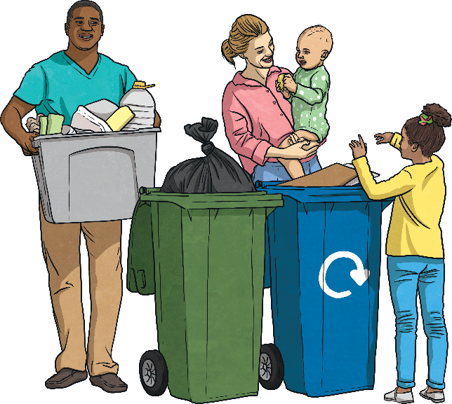
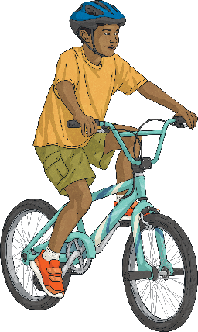
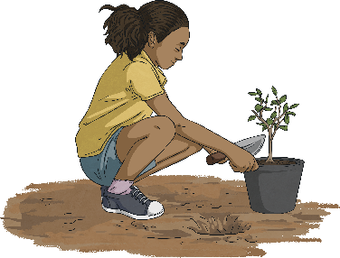
What Can We Do to Help?
There are many things you can do to help protect the environment this Earth Day and every day. Every small action makes a difference – remember the power of the individual!
Can you think of any ideas?
Invest in your local area.
Try to reduce car travel.
Try to choose more local, seasonal food.
Reduce, reuse, recycle!

Slide 10
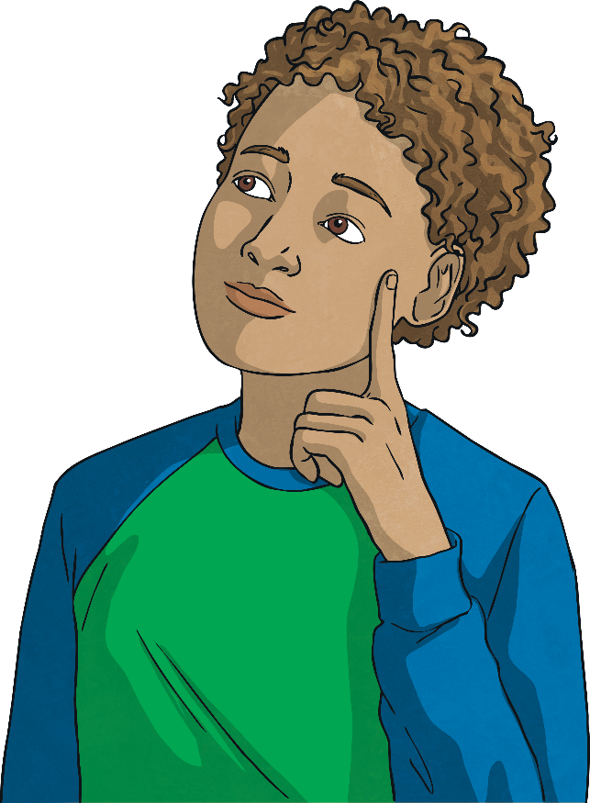
Reflection
Take a minute to think about these questions. Can you think of a pledge (promise) you could make this Earth Day to help protect the environment?
Why do you think it is important to recognise Earth Day?
Are there any of your daily or weekly habits you could change to make them more sustainable?
What is your Earth Day pledge?
Now, why not discuss your learning and Earth Day pledge with a grown-up after school?

Slide 11


