Slide 1
“To be the best we can be for ourselves and others”

Slide 2

The grace of our Lord Jesus Christ, the love of God and the fellowship of the Holy Spirit be with you
and also with you.

Slide 3
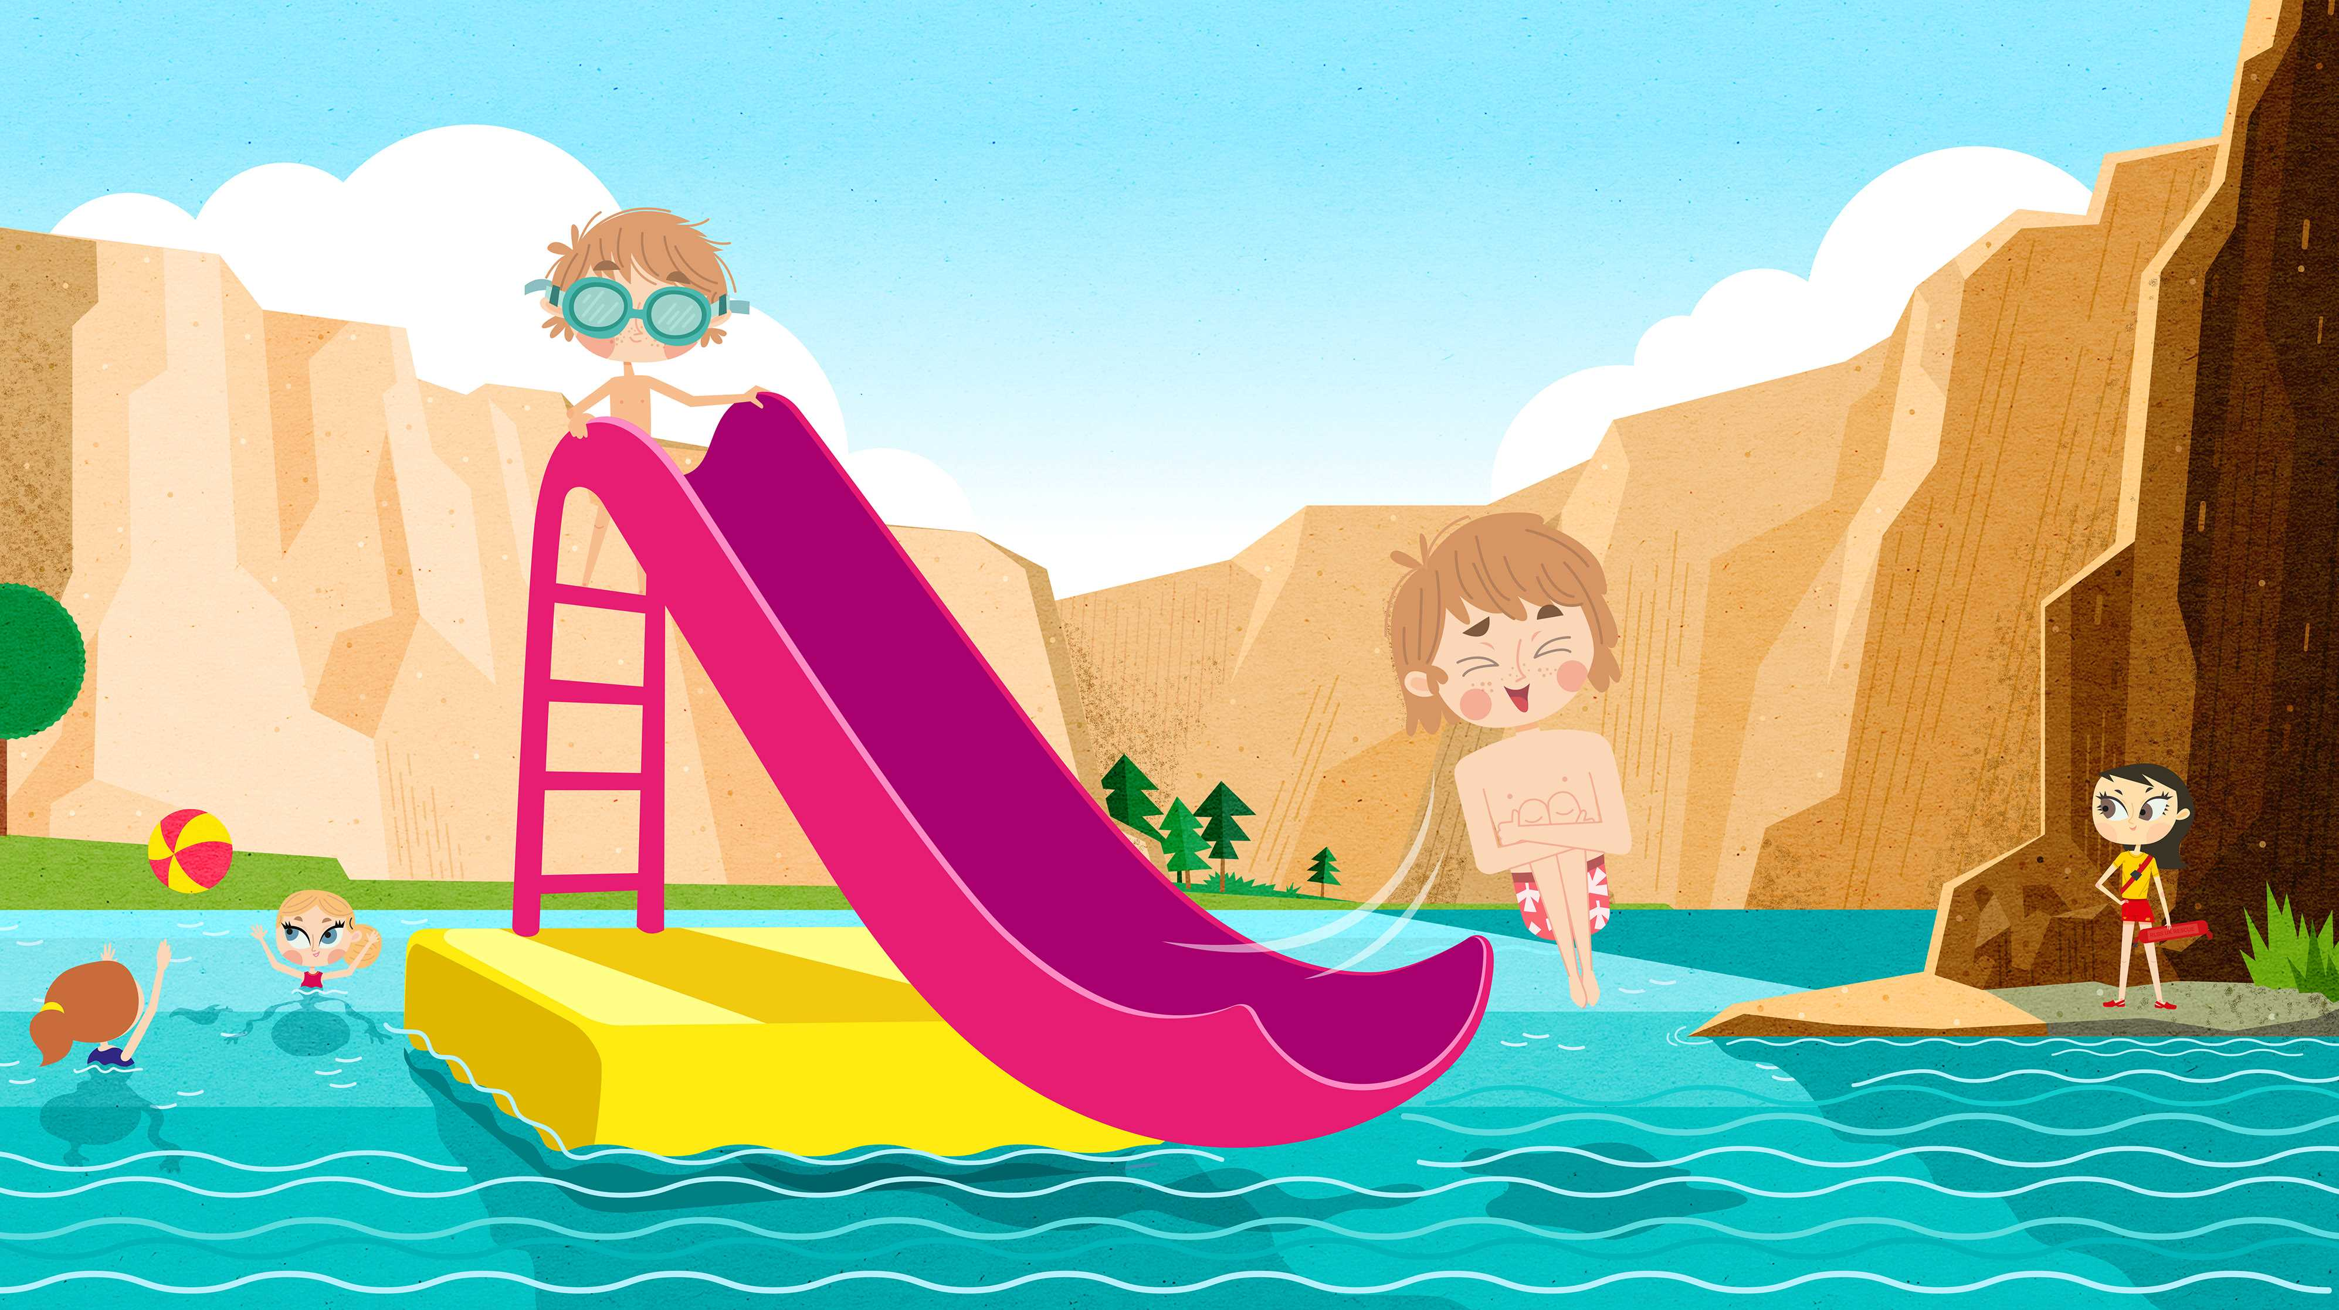
Water is fun!
Royal Life Saving Society UK – www.rlss.org.uk
Notes:
Begin by asking the children about the fun things they can do in, on and around water. If necessary, prompt them by asking who goes swimming, who goes to the beach, who walks near rivers etc.

Slide 4
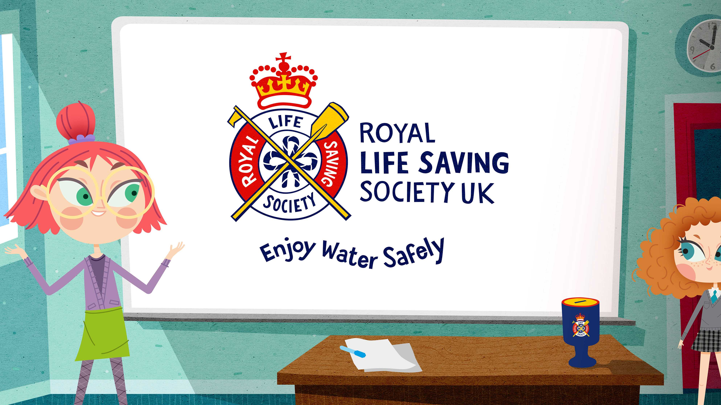
What different types of water are there?
Swimming pools
Rivers
Hot tubs
Canals
How many did you guess?!
Ponds
The sea
Lakes
Streams
Baths
Reservoirs
Royal Life Saving Society UK – www.rlss.org.uk
Notes:
Ask the question. To avoid answers such as ‘bottled’ or ‘fizzy’, give an initial prompt such as ‘river’ or ‘canal.’ Allow the children some talk time amongst themselves or with a partner, then take answers and briefly discuss with reference to local bodies of water that the children may already be familiar with.
End with the question: is it always safe to play on these types of water? Take a snap survey: who thinks yes, who thinks no? Are some places safer than others? Why might that be?

Slide 5
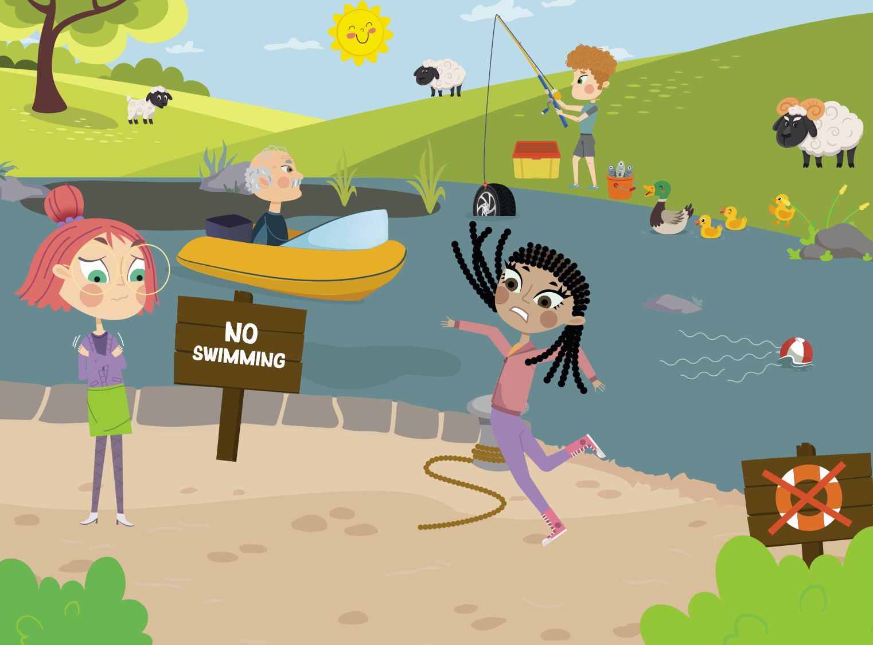
Notes:
After the discussion on keeping safe, ask the students if they can spot any dangers or potential issues in the picture above.
There are at least 9 issues: 1. Trip hazards. 2. Muddy water. 3. Broken rescue equipment. 4. Man on boat doesn’t have a life jacket. 5. Currents can drag you away. 6. Slippery banks. 7. Weeds / branches can trap you in the water. 8. Cold water can affect your ability to swim (cold water shock). 9. hidden rubbish beneath the surface can trap you.

Slide 6
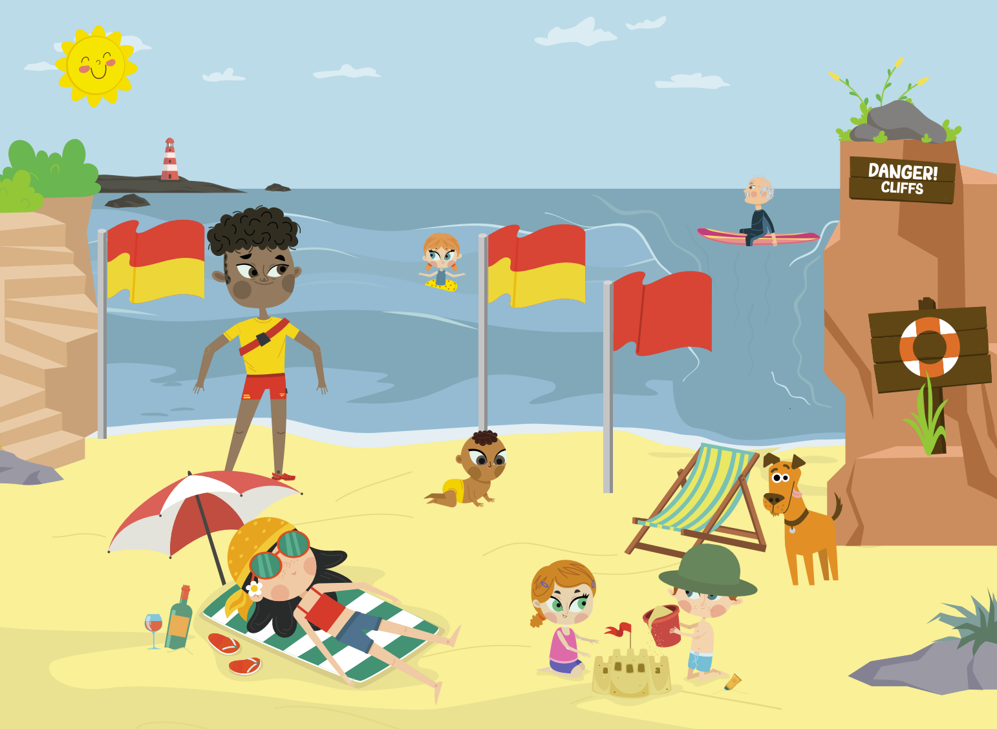
Water safety at the beach
Notes:
After the discussion on keeping safe, ask the students if they can spot any dangers or potential issues in the picture above.
There are 10 points: 1. Cliffs can be dangerous. 2. Strong currents (rip currents) can carry you out to sea. 3. Water can be too deep or too shallow. 4. Red beach flag means danger – no swimming. 5. Red and yellow beach flags mean this is a safe zone and lifeguards are watching. 6. Beaches can be sunny and windy –always wear sunscreen and a hat so you don’t burn. 7. Don’t eat or drink before going in the water. 8. Look for safety equipment. 9 Always listen to lifeguards. Always stay with someone – never go off on your own. 10. never use inflatables in the sea – winds and currents can carry you out into deep water.

Slide 7
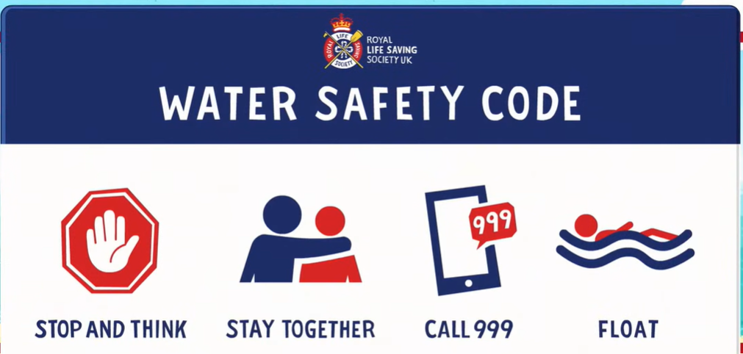
https://www.youtube.com/watch?v=zwzB7So7jSM
Royal Life Saving Society UK – www.rlss.org.uk
Notes:
Explain that to help keep us safe in and around water, we are going to learn all about the Water Safety Code and that we are going to watch a short cartoon to help us. Click on ‘The Water Safety Code’ title to view the video. At the end of the video, ask if there are any questions. This will also be an opportunity to address any misconceptions.

Slide 8
Cold Water Shock
When you enter cold water unexpectedly, your body doesn’t ask for permission to react; it enters a state of physiological panic.
The Involuntary Gasp: The sudden drop in skin temperature triggers a massive intake of air. If your head is underwater, you will inhale water directly into your lungs.
Hyperventilation: Your breathing rate can increase by up to 10 times. This leads to panic and a feeling of suffocation.
Cardiac Stress: Your blood vessels constrict instantly, causing a spike in blood pressure that can lead to cardiac arrest, even in healthy individuals.

Slide 9
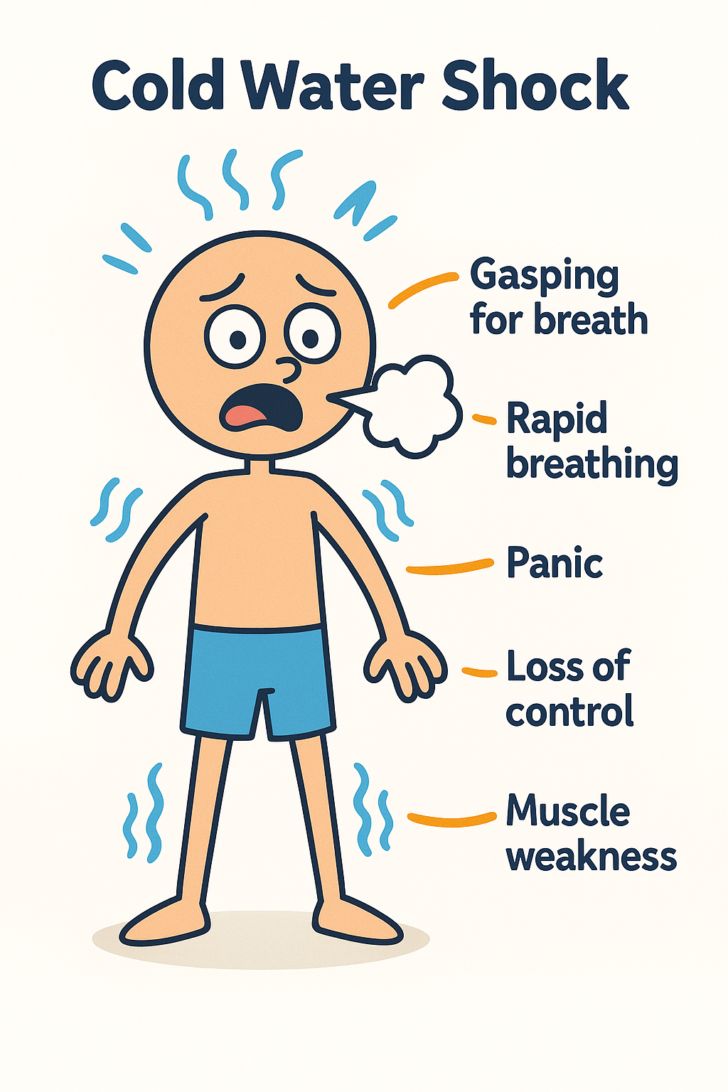
When you enter cold water unexpectedly, your body doesn’t ask for permission to react; it enters a state of physiological panic.
The Involuntary Gasp: The sudden drop in skin temperature triggers a massive intake of air. If your head is underwater, you will inhale water directly into your lungs.
Hyperventilation: Your breathing rate can increase by up to 10 times. This leads to panic and a feeling of suffocation.
Cardiac Stress: Your blood vessels constrict instantly, causing a spike in blood pressure that can lead to cardiac arrest, even in healthy individuals

Slide 10
Even strong swimmers experience
Cold Water Shock!

Slide 11
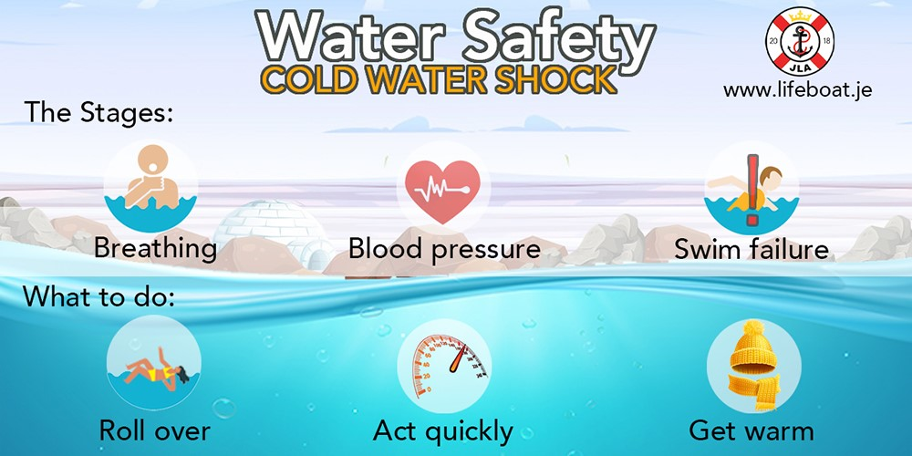

Slide 12
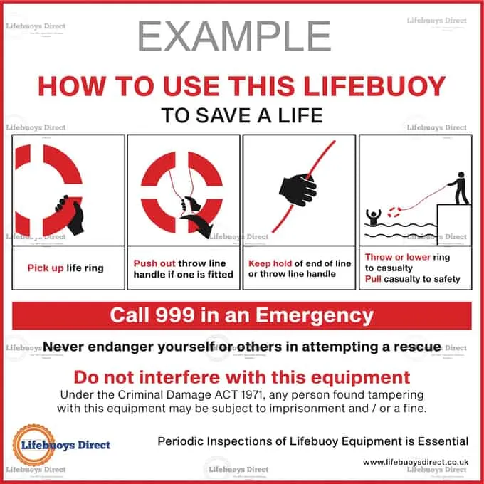
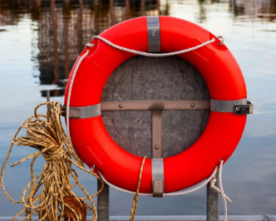
Life Rings/Life Buoy

Slide 13
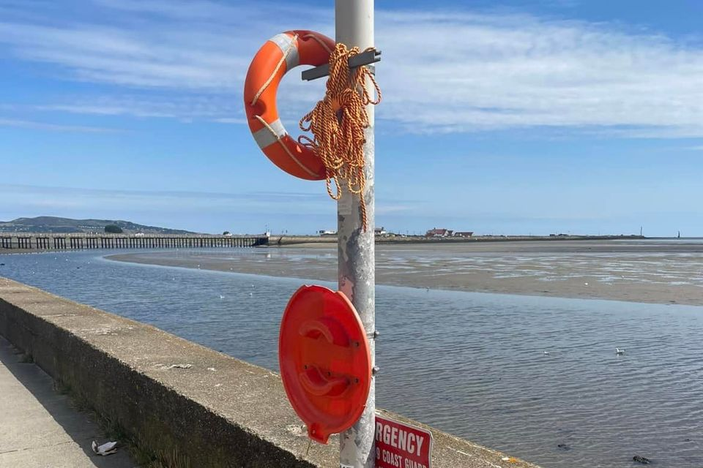
What is the problem here?

Slide 14
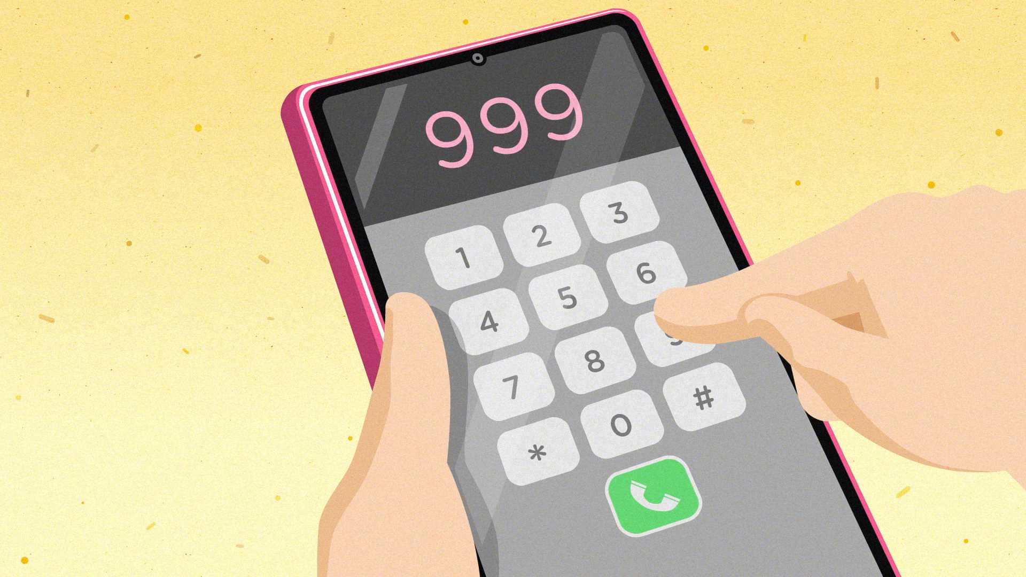
✅ Smart Safety Rules
Never swim alone
Always tell an adult
Swim where it's safe (organised events, lifeguarded locations)
Read warning signs and know where the life ring is located.
Call 999 immediately if someone is in trouble. DO NOT ENTER THE WATER

Slide 15
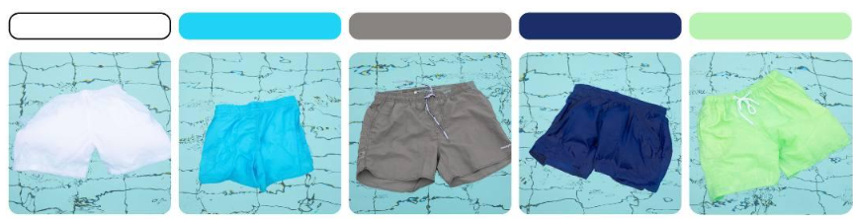
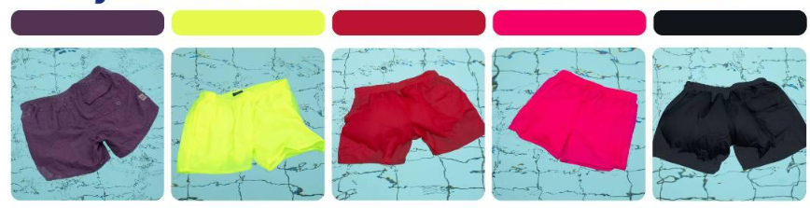

Slide 16


