Slide 1

Succeed ~ Happy ~ Independent ~ Nurtured ~ Excited
with perseverance ~ with respect & honesty ~ and courageous ~ with compassion~ with teamwork
“To be the best we can be for ourselves and others”

Slide 2
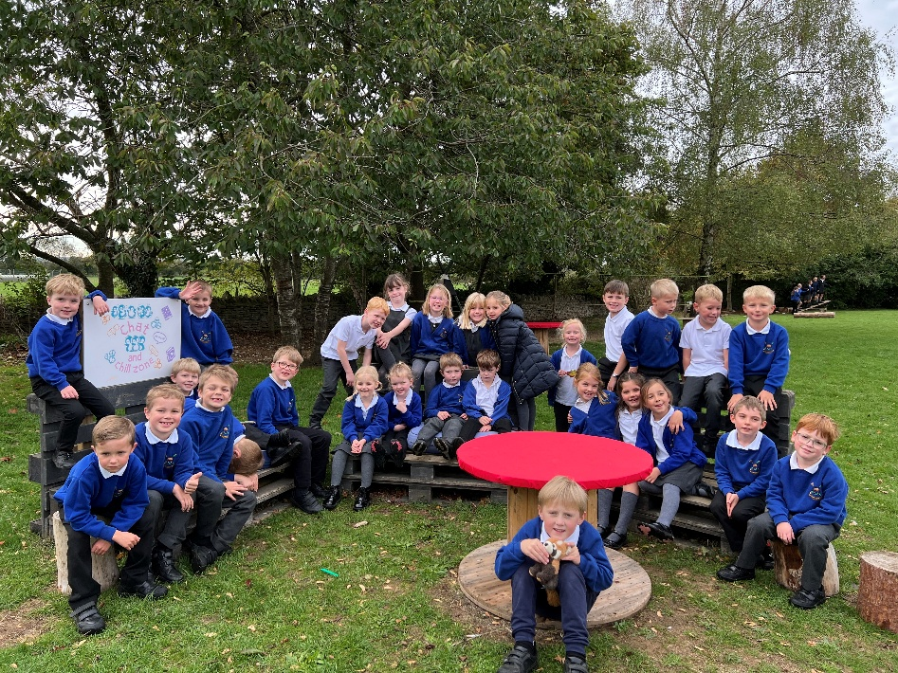
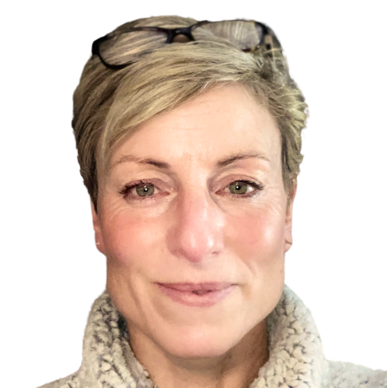
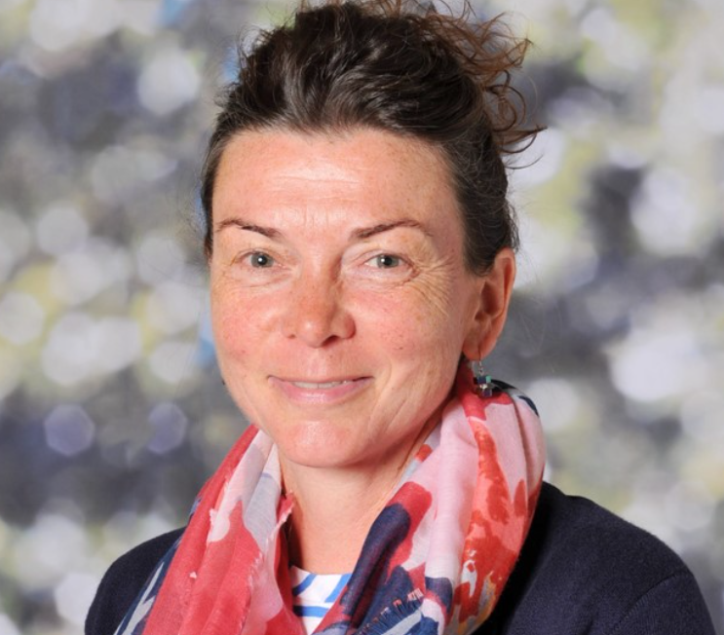
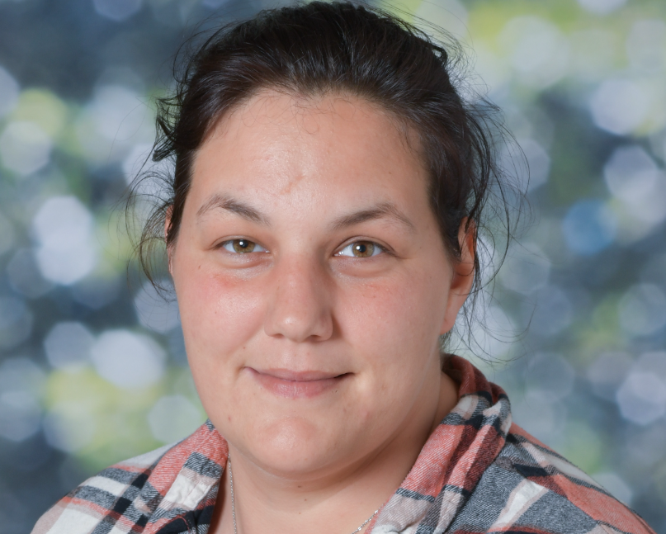
Welcome to Ginkgo Class
Year 2

Slide 3
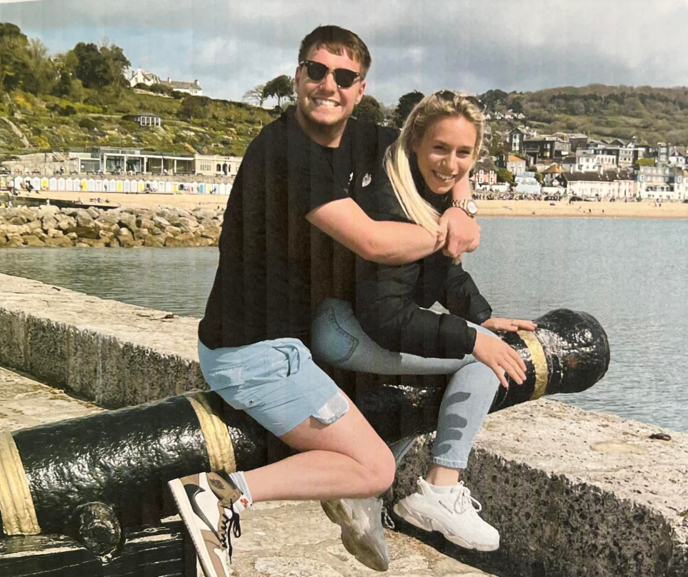
About me!
I am Mum to William and Isobel who are 26 and 24.
I have been a teacher for 30 years and worked with many different age groups. I was at Clanfield Primary School for 20 of those years and the reason I am still doing this job is simple. I love being part of a child’s journey and helping them to flourish and grow.
Every child has a super power and part of my role is helping them to find what theirs is and to nurture it.

Slide 4
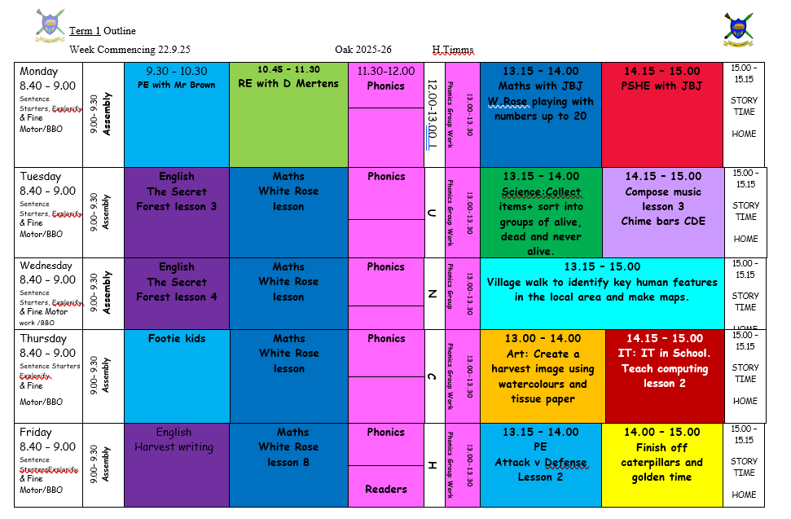

Slide 5
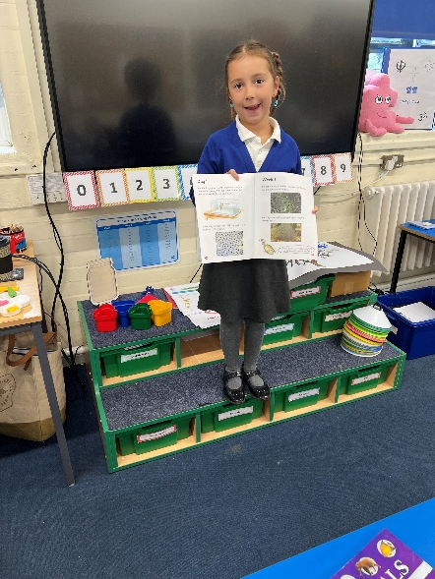
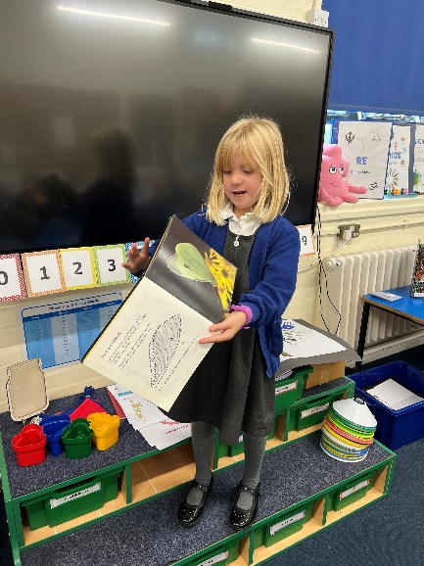
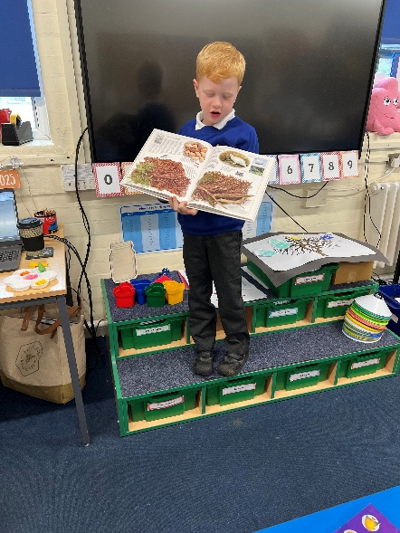
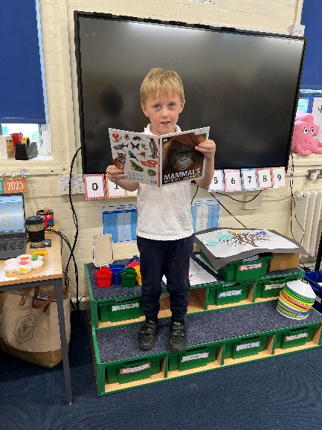
Early Morning Activity (EMA) and registration starts at 8.40am
Please be on time ☺
Handwriting
Recap on prior learning
Maths, Phonics, English and Science activities.

Slide 6

Rewards
Penguins
Traffic Lights
Reward Jar
House Tokens
‘Be the Best’ certificate

Slide 7

Phonics
Bug Club
Lesson Structure
Recap previous sounds
Focus sound
Reading
Spelling
Writing (incl. letter formation)
Sentence dictation

Slide 8
Reading
We teach reading in a variety of ways:
* Integrated into the curriculum
* Paired reading – this develops fluency and children can support each other
* In our English lessons we will be Investigating books deeply.
* ‘Deepening the moment’ with our reading skills by using VIPERS – increasing comprehension as well as fluency.
* Work on comprehension at home. Stop reading at various points and ask questions and also encourage reading with expression.
* When we read 1-2-1 at school we will be looking for these skills and seeing if children can apply their phonics knowledge, show great comprehension, expression and fluency.

Slide 9
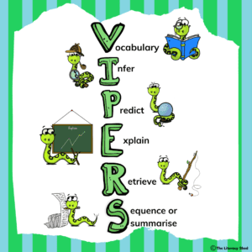

Slide 10

It is crucial for children to develop a
life-long love of reading.
It starts with you….
… and please let it
continue with you.
It is such an essential part of their development as a reader and you play a crucial role in nurturing their love of reading.

Slide 11
At St Christopher’s we understand how important reading to an adult is. Our whole school expectation is that children read to an adult six times a week (every day and once over the weekend).
This needs to be noted in your child’s reading record. Comments on how your child read, if they enjoyed the book or any challenges are very helpful.

Slide 12
Please ensure your child’s book is in school everyday.
Banded reading books will be changed once a week to give enough time to read and re-read, discuss, explore and develop expression.
We will listen to children read at least once a week and reading will also be part of our Phonics and English lessons as well as integrated throughout our curriculum.

Slide 13






Literacy
Engaging high-quality texts
Experience days – used to intrigue children
Exploring language and vocabulary
Developing sentence structure
Exploring grammar and developing spelling
Purposeful writing outcomes

Slide 14
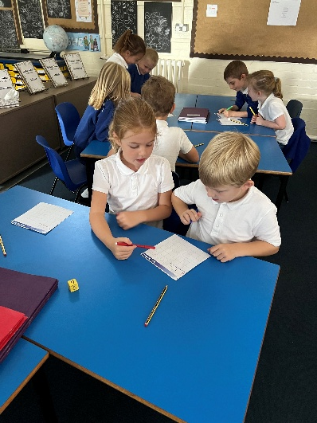
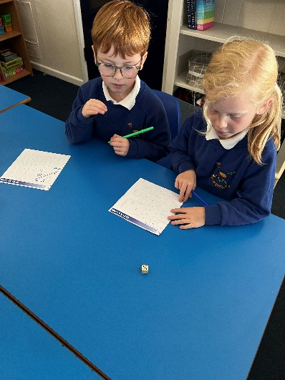
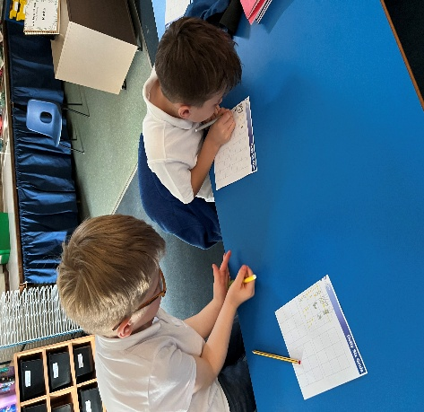
Developing a strong grounding in number is essential so that all children develop the necessary building blocks to excel mathematically.
It is important that children develop positive attitudes and interests in mathematics, look for patterns and relationships, spot connections, ‘have a go’, talk to adults and peers about what they notice and not be afraid to make mistakes.
Maths

Slide 15
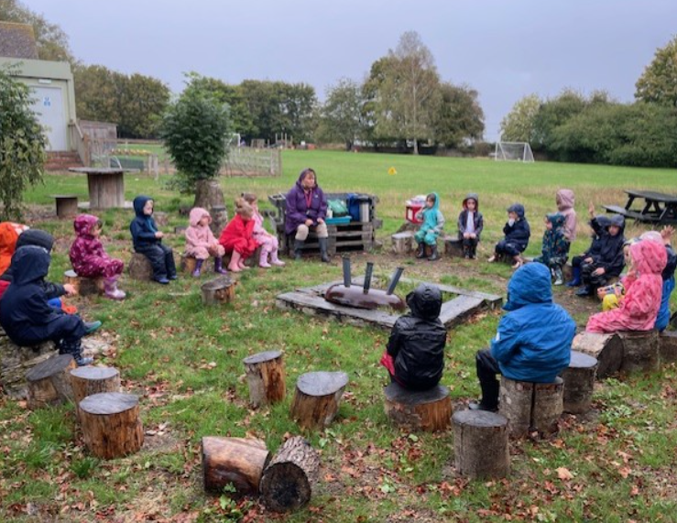
PE
Royal blue shorts/skort
White T-shirt
Kit available Mon-Fri
Mondays and Fridays.

Slide 16

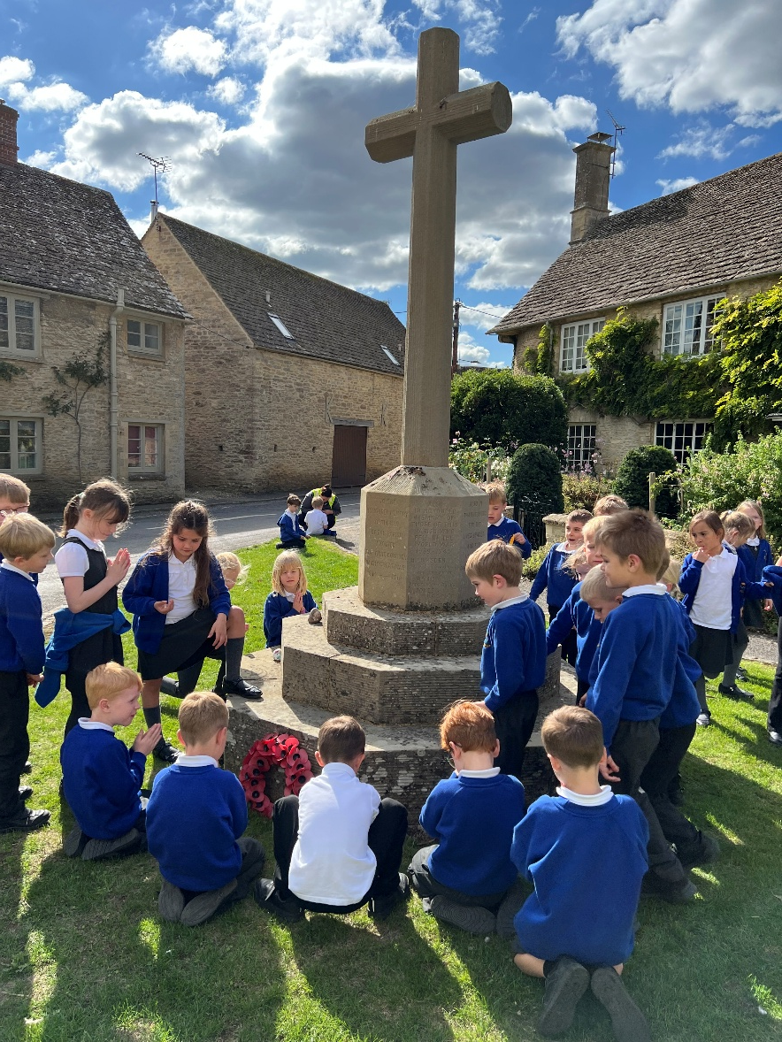
ClassDojo is used for us to communicate with one another. I will post photos and updates regularly and keep you updated on our class learning.
You can use the message part of the app to get in touch with me and I will check this between 8am and 5pm. For any urgent issues, please contact the school office.

Slide 17
Thank you for coming!
Any questions?

